Slide 1
Small-Proof Big-Data
Benchmark Result
4/25/2013

Slide 2
Benchmark Result
Parameters
  Security Parameter k: 32
  Max size of the stream n: 128
Execution time in seconds
#Update / #Query |  | 100 / 20 | 100 / 40 | 200 / 40
Prover | Update | 157.846 | 166.264 | 337.752
 | Query | 0.132 | 0.328 | 0.342
Verifier | Update | 0.071 | 0.072 | 0.143
 | Verify | 0.032 | 0.065 | 0.069

Slide 3
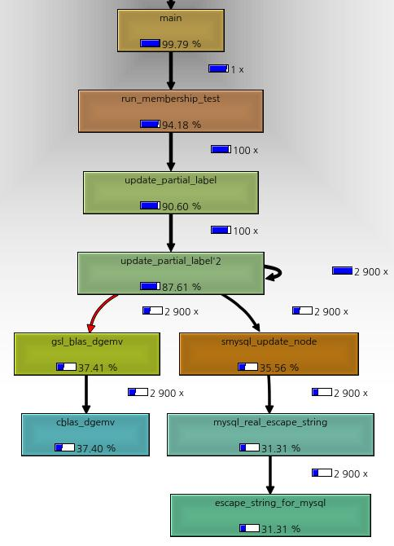
Prover Analysis
Callgrind
  Matrix-Vector product for label update (37.41%)
  Data conversion for MySQL (31.31%)
  Binary representation for label-to-digest conversion (4.48%)

